Slide 1

Sacramento: 2008 vs 2018
A Decade of a Difference
Victor Baker
Courtney Hyland
Maria Ramirez

Slide 2
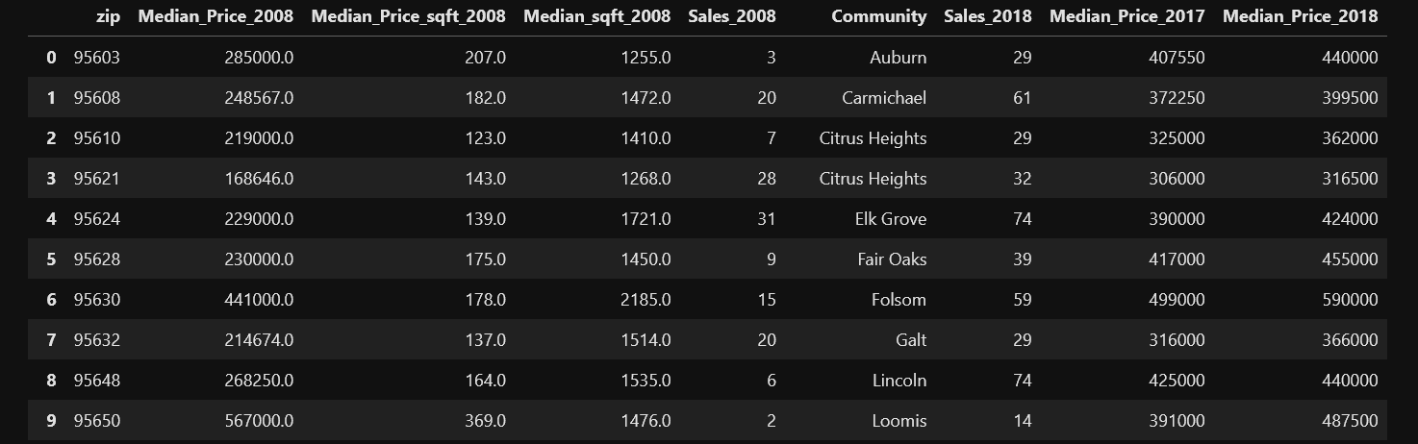
Overview:
We imported data(2008) used for the Sacramento Real Estate in Project 1, and have gathered new data from 2018.
We want to make comparisons for the median price and amount of houses sold between 2008 vs 2018.

Slide 3

ETL Process
Extract:
We are extracting from the 2008 and 2018 housing data csvs’.
Transform:
We combined both sources in order to create one final csv from which to pull our data from.
Load:
Created final tables into our database, showing the comparisons of our data.

Slide 4
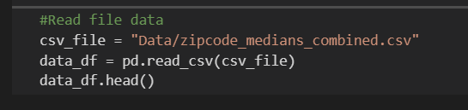
Extract
We utilized pandas in order to read our final merged csv file that consisted of the 2008 and 2018 data.

Slide 5
Transform
Using the new csv containing all merged data we created a new table displaying the 2008 and 2018 data values.

Slide 6
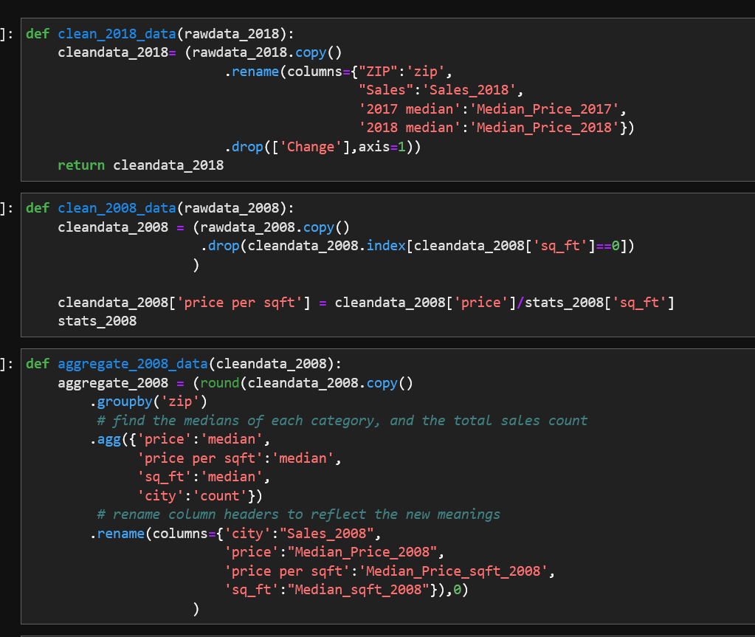
Transform cont.
We wanted to see the changes in home values from 2008 - 2018, we used the existing data to find the median price per zip code and compared it to the 2018 data.

Slide 7
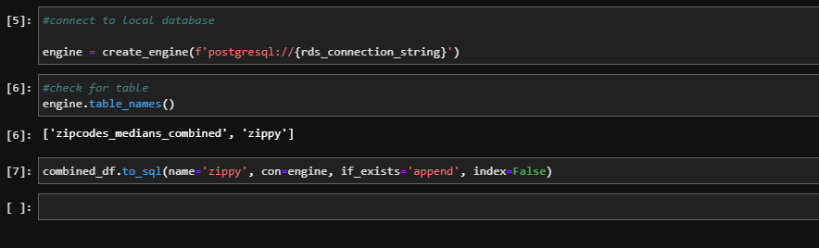
Load
The data was ready to be sent to the pgAdmin database

Slide 8
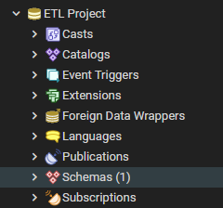
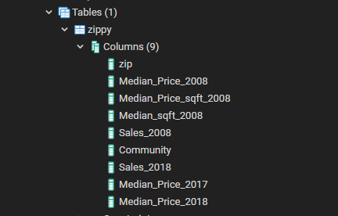
Load cont.
The data load to pgAdmin4 was successful

Slide 9
143%
Increase in homes sold in 2018 compared to 2008
55%
Increase in home sale price

Slide 10
Works Cited:
Project 1 Sources:
•https://support.spatialkey.com/spatialkey-sample-csv-data/
•https://support.spatialkey.com/spatialkey-sample-csv-data/
•https://account.sacbee.com/paywall/subscriber-only?resume=250652634
Additional Sources:
•https://www.sacbee.com/news/business/real-estate-news/article224544825.html

Slide 11

Questions?

